Slide 1
Data Presentation
Marketing Analytics Portfolio Project

Slide 2
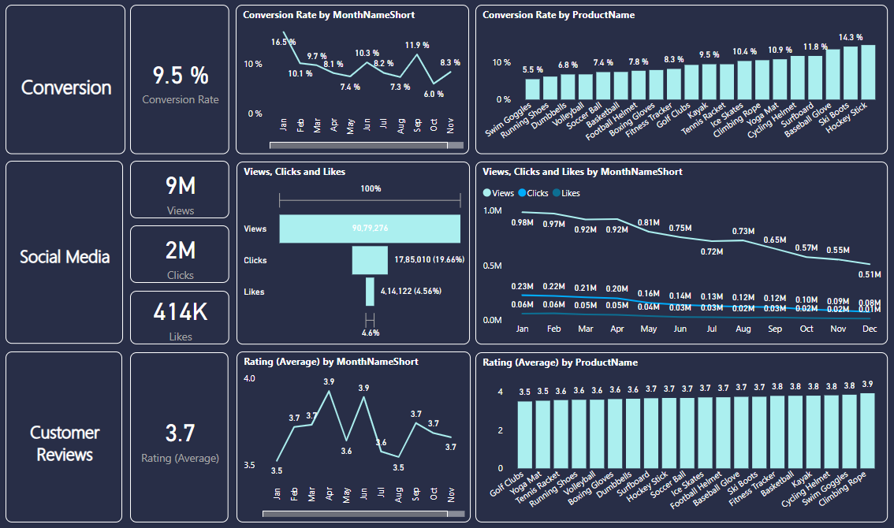
Overview
Decreased Conversion Rates: The conversion rate demonstrated a strong rebound in December, reaching 8.3%, despite a notable dip to 6.0% in October.
Reduced Customer Engagement:
There is a decline in overall social media engagement, with views dropping throughout the year.
While clicks and likes are low compared to views, the click-through rate stands at 19.66%, meaning that engaged users are still interacting effectively.
Customer Feedback Analysis:
Customer ratings have remained consistent, averaging around 3.7 throughout the year.
Although stable, the average rating is below the target of 4.0, suggesting a need for focused improvements in customer satisfaction, for products below 3,5.

Slide 3
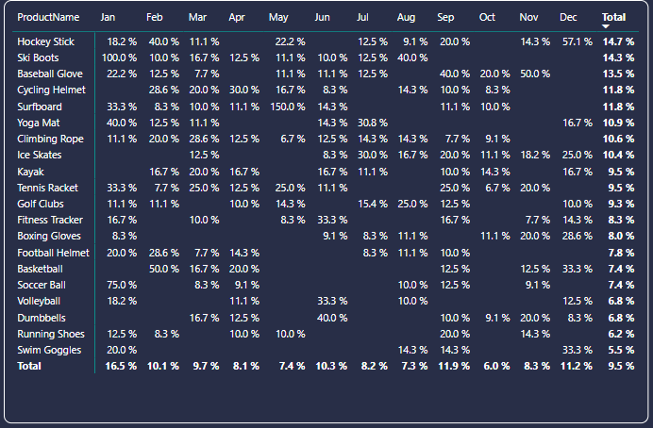
Decreased Conversion Rates
General Conversion Trend:
Throughout the year, conversion rates varied, with higher numbers of products converting successfully in months like January, July, September. This suggests that while some products had strong seasonal peaks, there is potential to improve conversions in lower-performing months through targeted interventions.
Lowest Conversion Month:
Aug experienced the lowest overall conversion rate at 7.3%, with no products standing out significantly in terms of conversion. This indicates a potential need to revisit marketing strategies or promotions during this period to boost performance.
Highest Conversion Rates:
January recorded the highest overall conversion rate at 16.5%, driven significantly by the Ski Boots with a remarkable 100% conversion. This indicates a strong start to the year, likely fueled by seasonal demand and effective marketing strategies.

Slide 4
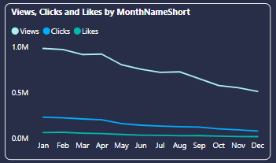
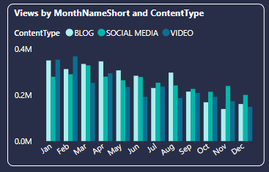
Reduced Customer Engagement
Declining Views:
Views peaked in February and July but declined from August and on, indicating reduced audience engagement in the later half of the year.
Low Interaction Rates:
Clicks and likes remained consistently low compared to views, suggesting the need for more engaging content or stronger calls to action.
Content Type Performance:
Blog content drove the most views, especially in March and May, while social media and video content maintained steady but slightly lower engagement.

Slide 5
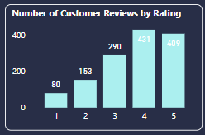
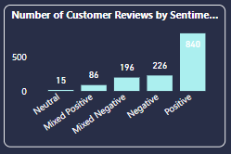
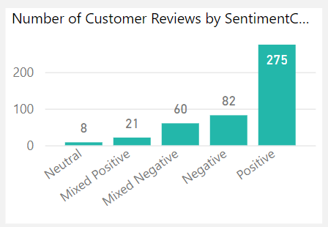
Customer Feedback Analysis
Customer Ratings Distribution:
The majority of customer reviews are in the higher ratings, with 431 reviews at 4 stars and 409 reviews at 5 stars, indicating overall positive feedback. Lower ratings (1-2 stars) account for a smaller proportion, with 80 reviews at 1 star and 153 reviews at 2 stars.
Sentiment Analysis:
Positive sentiment dominates with 840 reviews, reflecting a generally satisfied customer base. Negative sentiment is present in 226 reviews, with a smaller number of mixed and neutral sentiments, suggesting some areas for improvement but overall strong customer approval.
Opportunity for Improvement:
The presence of mixed positive and mixed negative sentiments suggests that there are opportunities to convert those mixed experiences into more clearly positive ones, potentially boosting overall ratings. Addressing the specific concerns in mixed reviews could elevate customer satisfaction.

Slide 6
Goals & Actions
Goals
Actions
Increase Conversion Rates:
Goal: Identify factors impacting the conversion rate and provide recommendations to improve it.
Insight: Highlight key stages where visitors drop off and suggest improvements to optimize the conversion funnel.
Enhance Customer Engagement:
Goal: Determine which types of content drive the highest engagement.
Insight: Analyze interaction levels with different types of marketing content to inform better content strategies.
Improve Customer Feedback Scores:
Goal: Understand common themes in customer reviews and provide actionable insights.
Insight: Identify recurring positive and negative feedback to guide product and service improvements.
Increase Conversion Rates:
Target High-Performing Product Categories: Focus marketing efforts on products with demonstrated high conversion rates, such as Kayaks, Ski Boots, and Baseball Gloves. Implement seasonal promotions or personalized campaigns during peak months (e.g., January and September) to capitalize on these trends.
Enhance Customer Engagement:
Revitalize Content Strategy: To turn around declining views and low interaction rates, experiment with more engaging content formats, such as interactive videos or user-generated content. Additionally, boost engagement by optimizing call-to-action placement in social media and blog content, particularly during historically lower-engagement months (September-December).
Improve Customer Feedback Scores:
Address Mixed and Negative Feedback: Implement a feedback loop where mixed and negative reviews are analyzed to identify common issues. Develop improvement plans to address these concerns. Consider following up with dissatisfied customers to resolve issues and encourage re-rating, aiming to move average ratings closer to the 4.0 target.

